Slide 1

CNN Spatial
Optimizations
CRML Lab
The Technion
Inna Batenkov
Ido Imanuel
Supervised by Gil Shomron

Slide 2

Project Goals
Acquire knowledge on CNNs
Build an end-to-end framework for
Cross Neuron Predictions
Develop a prediction mask optimization
scheme
Analyze MAC operation savings on various
networks and datasets

Slide 3
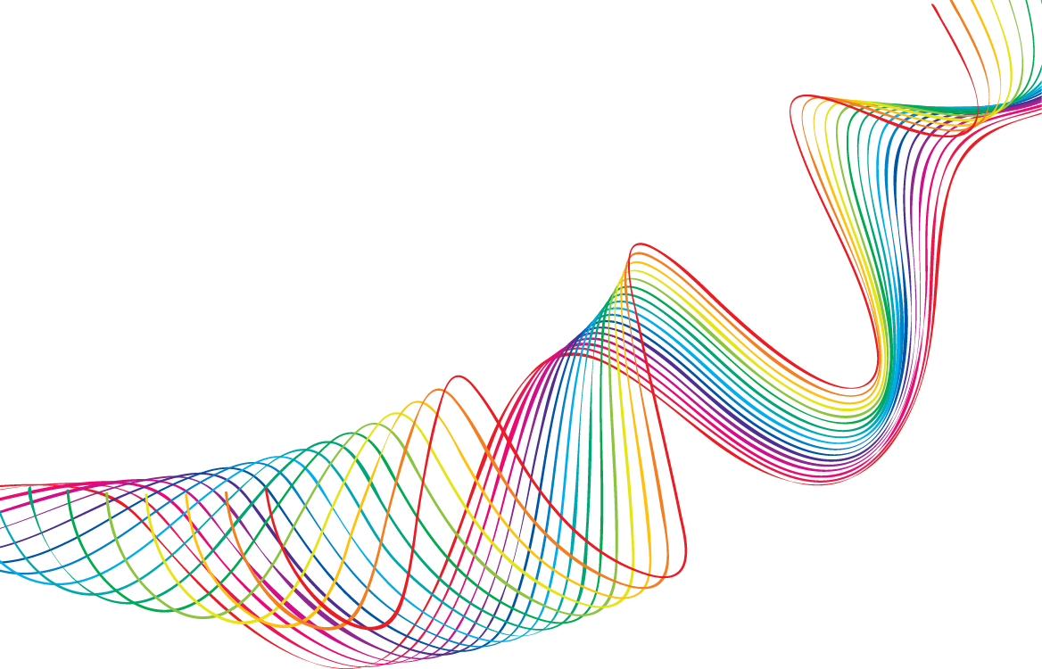
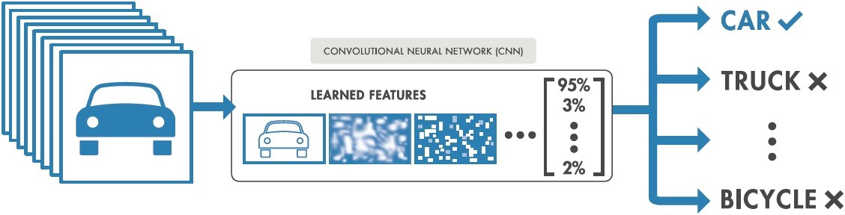
Convolution Nets
Notes:
Present the CNN as a black-box, allowing input of images (RGB or Grey Scale) and outputting a vector of probabilities, classifying each image to a specific class. Present the Forward Pass and the Backward pass as a Feedback system.

Slide 4
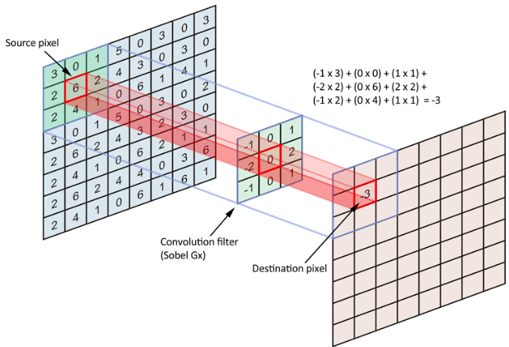

Convolution Nets
Notes:
Present the actual representation of an image as matrix of numbers. Explain the Convlution operator, with the Sobel filter. Talk about replacing the filter with a learned filter of varying weights.

Slide 5
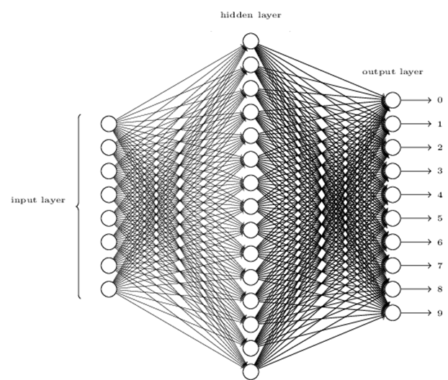

Net Collaterals
Notes:
Talk about the Dense/Fully Connected and Activation roles. Talk about how there are more than just these (Like Dropout/Pooling) – but these suffice for this presentation.

Slide 6
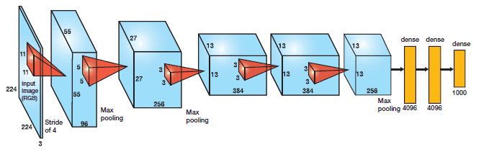
AlexNet - 2012
Notes:
Talk about the AlexNet architecture and the number of filters in each layer. Remind that this DNN won the ImgNet classification contest back in 2012 by a vast amount.

Slide 7

Power Considerations in CNNs
Can we make Machine Learning portable to battery powered mobile devices?
Notes:
Main Research question – How can we reduce power in CNNs?
(1) Smaller DNNs require less communication across servers during distributed training.
(2) Smaller DNNs require less bandwidth to export a new model from the cloud to an autonomous car.
(3) Smaller DNNs are more feasible to deploy on FPGAs and other hardware with limited memory.
Show the demo, and explain about output feature maps and input feature maps and the seriality of the computation.

Slide 8
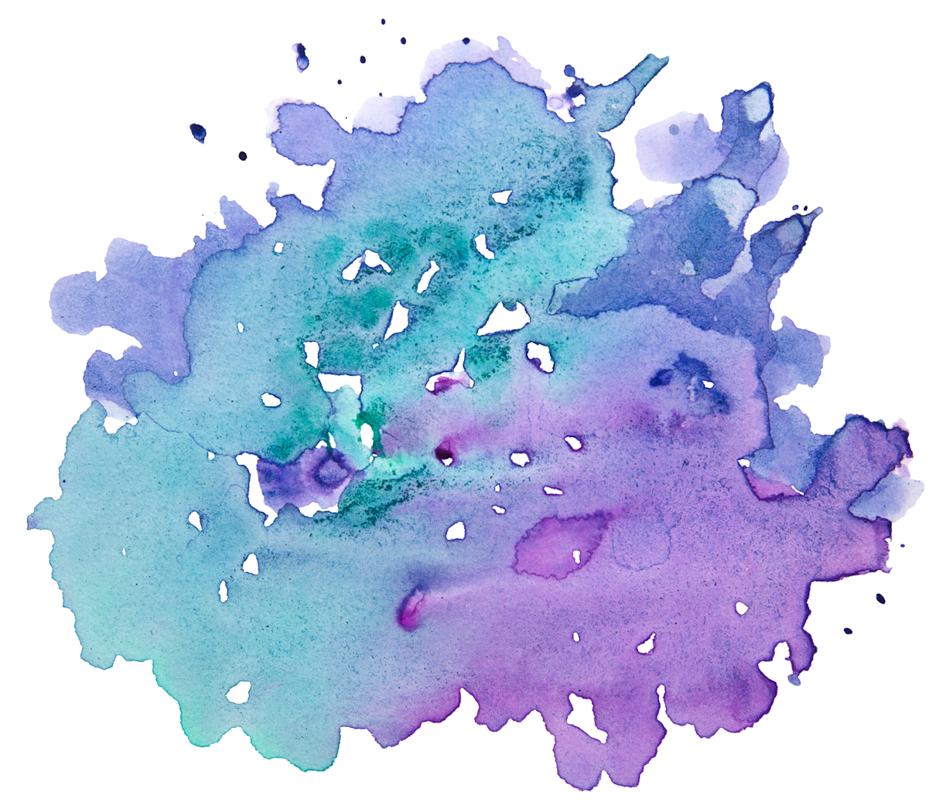
This work:
More than 25% of all MAC operations are redundant
Can we utilize this to save power?
Notes:
AlexNet, CIFAR10, stems from out statistics.

Slide 9
Project Goals
Acquire knowledge on CNNs
Build an end-to-end framework for
Cross Neuron Predictions
Develop a prediction mask optimization
scheme
Analyze MAC operation savings on various
networks and datasets

Slide 10

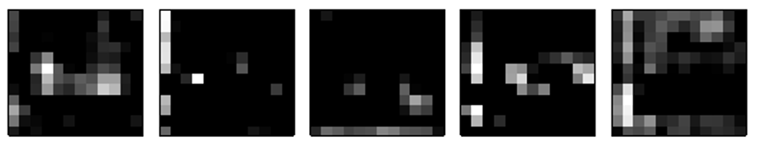

Core Ideas
Relu is common: Due to its relative simplicity and fast convergence rate, Relu is currently the most popular activation method
Spatial Correlation: There is a large correlation between nearby pixels
Non-positive convolution values turn zeros: Relu thresholds any negative values to 0
Notes:
The maps are taken from the CNP article. These are examples of AlexNet CONV3 ofmaps (after Relu) for five arbitrary filter channels. Spatial correlation is evident. Black pixels are zero.

Slide 11
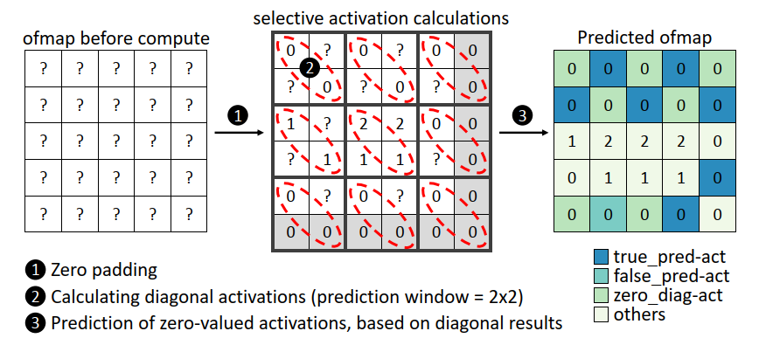
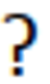
Cross Neuron Predictions
The Good:
For a good prediction, we save as many MAC operations as there are zeros in the prediction mask
The Bad: Bad predictions may degrade classification accuracy

Slide 12
Project Goals
Acquire knowledge on CNNs
Build an end-to-end framework for
Cross Neuron Predictions
Develop a prediction mask optimization
scheme
Analyze MAC operation savings on various
networks and datasets

Slide 13
Optimizing Prediction masks

Slide 14
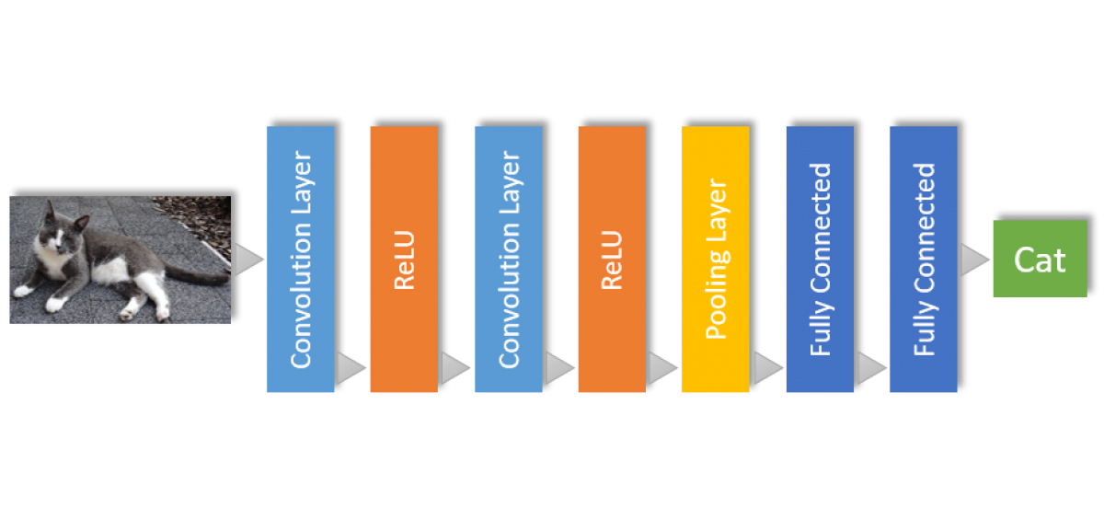

CNP Simulations
Utilizing PyTorch Layers: We create a custom “Spatial” layer, responsible for collecting MAC operation statistics with each forward run of the CNN. These layers are placed after Conv & Relu layers
Spatial
Spatial

Slide 15
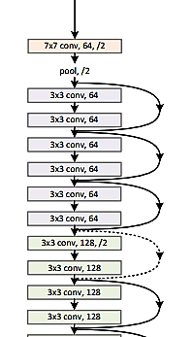
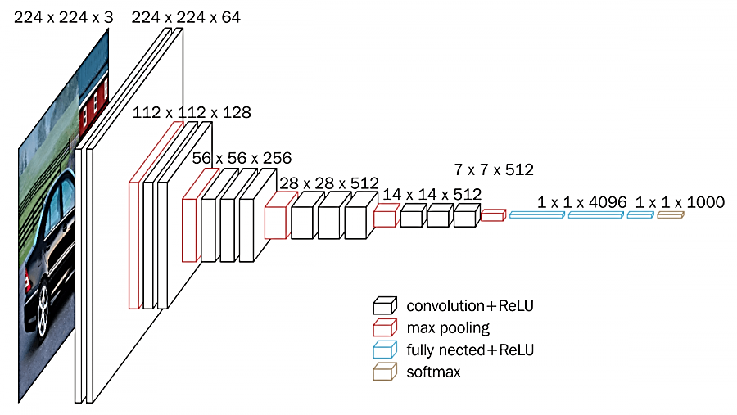
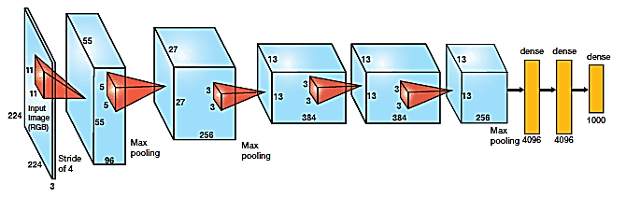
CNP Simulations
Generalizing to other architectures: We allow generalization of CNP testing to any network architecture with the SpatialNet class family, and implement for AlexNet, ResNet18, ResNet34 and VGG16

Slide 16
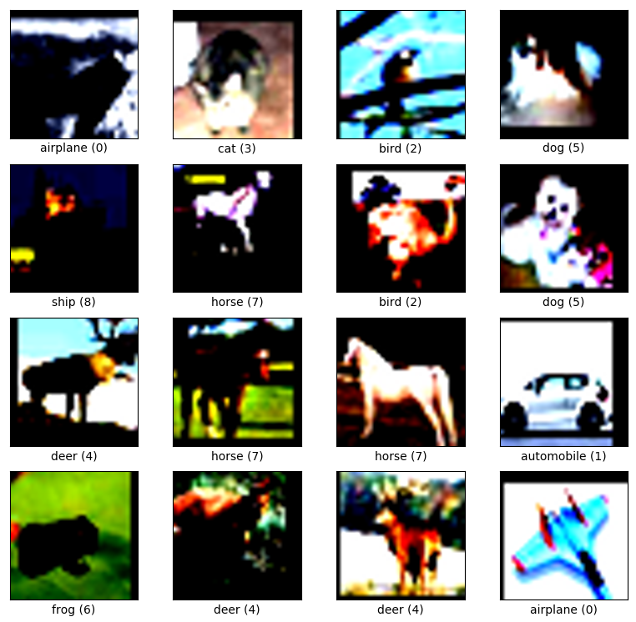
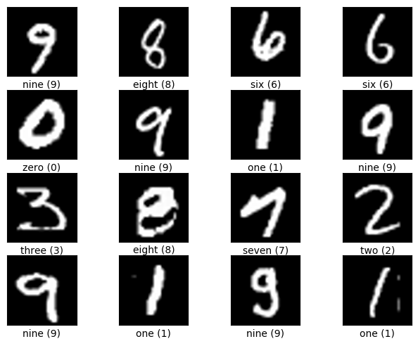
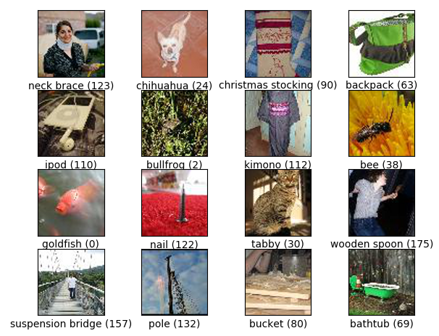
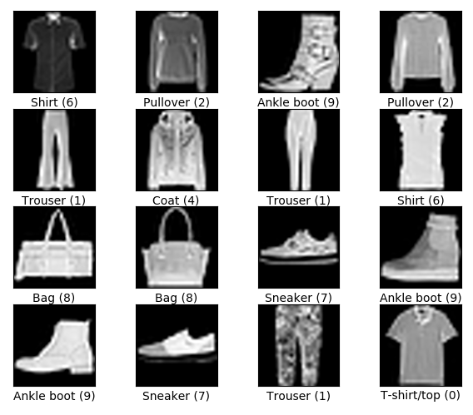
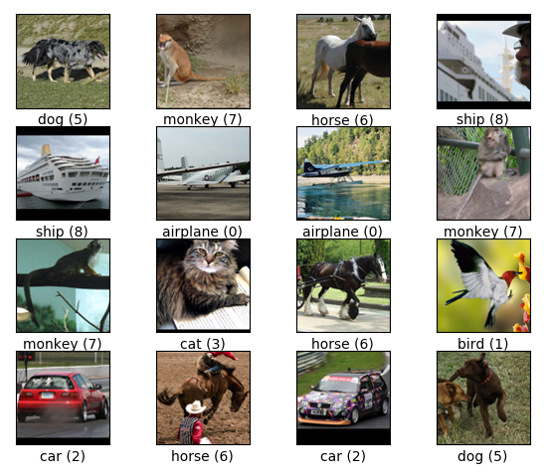
CNP Simulations
Dataset Generality: Input layers, output and fully connected layers are tailored to a specific dataset. We embed flexibility in the network build phase, allowing for testing on any dataset chosen
CIFAR10,
32x32 RGB
MNIST,
28x28 Grey
ImgNet,
256x256 RGB
FashionMNIST,
28x28 Grey
STL10,
96x96 RGB

Slide 17
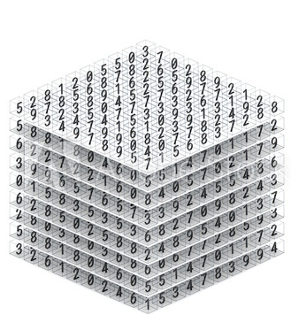
Optimization Troubles
First layer of AlexNet has 96 filters of size 11x11
With an input size of 227x227, we receive a 96x55x55 ofmap, which will be inserted to the Spatial layer.
With a patch size of 2x2, we split the map into 2x2 blocks. We zero-pad to 96x56x56 and we receive N slots where:
We now have different mask configurations to choose from, making this problem incomputable and most likely, NP-Hard
Example of an output feature map
(ofmap)
Notes:
And this is only for the first layer. Explain that each configuration needs a +1ms forward run to calculate the op savings + current accuracy.

Slide 18

Greedy Optimizations
How can we escape a combinatorial explosion?

Slide 19
Core Presumption
No correlation assumption:
Given N patches, optimizing jointly for all patches is equivalent to N sole optimization tasks of each.
Note: This is clearly not withheld:
Ofmaps from deep layers are derived directly from ofmaps of shallower layers.

Slide 20
No correlation Optimization
Patch Channel
Layer Network
Notes:
And this is only for the first layer. Explain that each configuration needs a +1ms forward run to calculate the op savings + current accuracy.

Slide 21

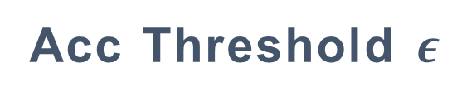
Input Parameters
CNN Network
Dataset
Acc Threshold $ε$
ResNet18
ResNet34
AlexNet
VGG16
CIFAR10
MNIST
FashionMNIST
ImgNet
STL10
Maximal allowed accuracy loss

Slide 22
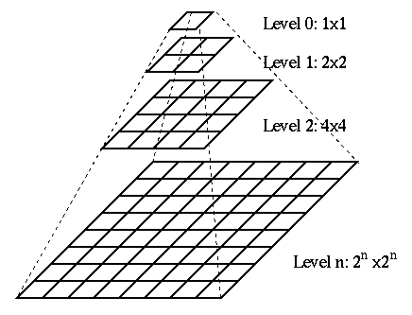
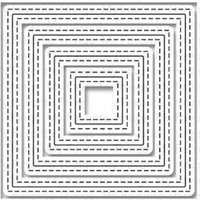

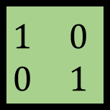
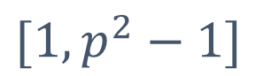
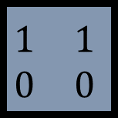
Input Parameters
$$[1,p^{2}−1]$$
Patch Size
Patterns/
Ones Range
GT
Granularity Threshold
Only in Max Granularity Mode
The spread of a single estimator block
Size of the estimator block
p x p
Possible patterns of the estimator block
$$\begin{matrix}1 & 0 \\ 0 & 1\end{matrix}$$
$$\begin{matrix}1 & 0 \\ 0 & 0\end{matrix}$$
$$\begin{matrix}1 & 1 \\ 0 & 0\end{matrix}$$

Slide 23
Input Parameters
Max Granularity
Uniform Filters
Uniform Patch
Mode
Four different optimization modes
Uniform Layer

Slide 24
CNN
Optimizer
Dataset
First Level Optimization Pass
Neural Net
Start of the Optimization Algorithm Code Flow
Spatial
Layer
Spatial
Layer
Spatial
Layer
Mode
Test Set
Patch Size
Baseline calculation
Patterns/
Ones Range
Run Time Evaluation
GT

Slide 25

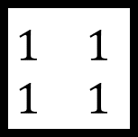
First Level Optimization Pass
$$\begin{matrix}1 & 1 \\ 1 & 1\end{matrix}$$
Default mask =
=
,
,
,
,
,
, …
,
,
, …

Slide 26
Patch Quantizer
1. Filter results and sort according to operations saved
#
1
2
3
,
#
1
2
3
, …
#
1
2
, …

Slide 27
Patch Quantizer
2. Create channels and simulate
#
#
1
2
3
1
2
3
1
2
3
1
2
#
#
,
,

Slide 28
Channel Quantizer
Same as patch quantizer, but for creating layers
#
#
1
2
3
1
#
#
#
#
1
2
2
3
#
#
#
1
2
3
3

Slide 29
Layer Quantizer
1. Take the best option for each layer
1
1
1
2. Update layer that has the:
maximal accuracy gain
minimal ops saved drop
1
2
1
,
2
2
1
…

Slide 30
Layer Quantizer
3. When reaching the last option for each layer,
start incorporating the default layer
3
3
3
3
3
,
,
3
,
4. Find and store the configuration thet meets the maximal
allowed accuracy loss

Slide 31
CNN
FLrec
Optimizer
Patch Quantizer
Dataset
First Level Optimization Pass
Neural Net
PQrec
Spatial
Layer
Spatial
Layer
Spatial
Layer
Channel Quantizer
Mode
CQrec
Test generator
Patch Size
Run Time Evaluation
Retraining
module
Layer Quantizer
LQrec
Patterns/
Ones Range
Final mask
Baseline calculation
Final result
after retraining
GT

Slide 32

Results

Slide 33
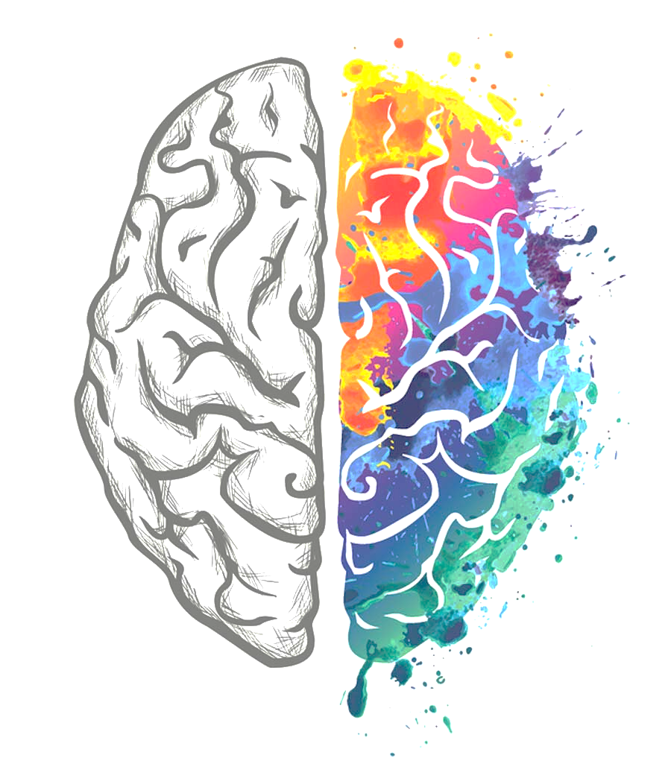
AlexNet, CIFAR10, 5 Spatial layers
Network was trained to a 75.8% 1-0 classification accuracy on CIFAR10 (10 classes).
We test our various optimization modes in contrast to the baseline result of all diagonal uniform network mask.
We receive a 14.1% decrease in accuracy, with 34% MAC operations saved for this configuration with a patch size of 3x3.

Slide 39
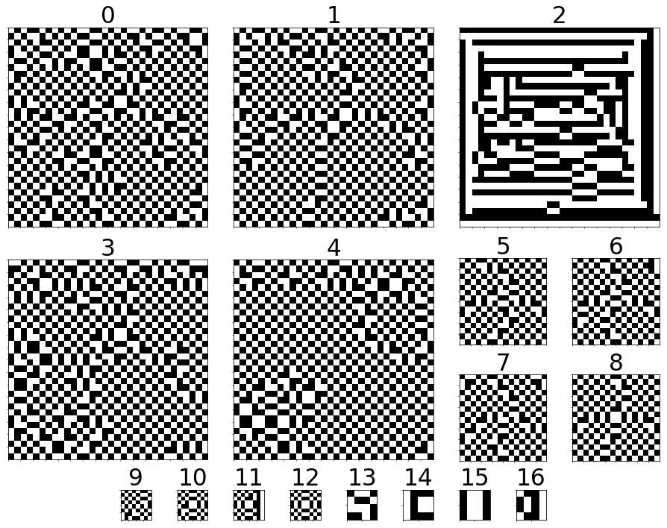

Slide 40
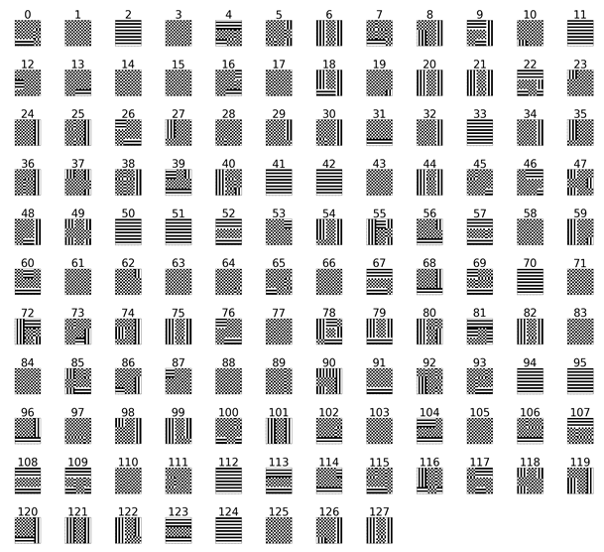

Slide 41
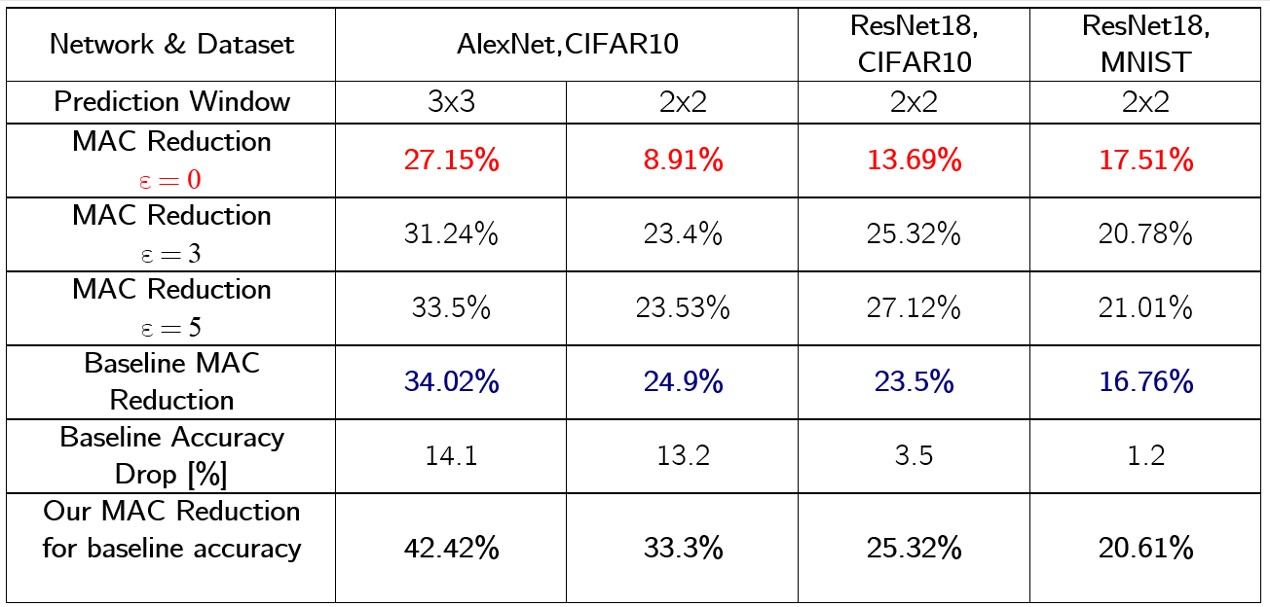

Slide 42
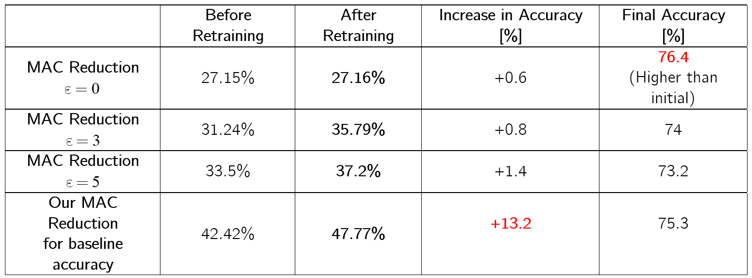

Slide 43
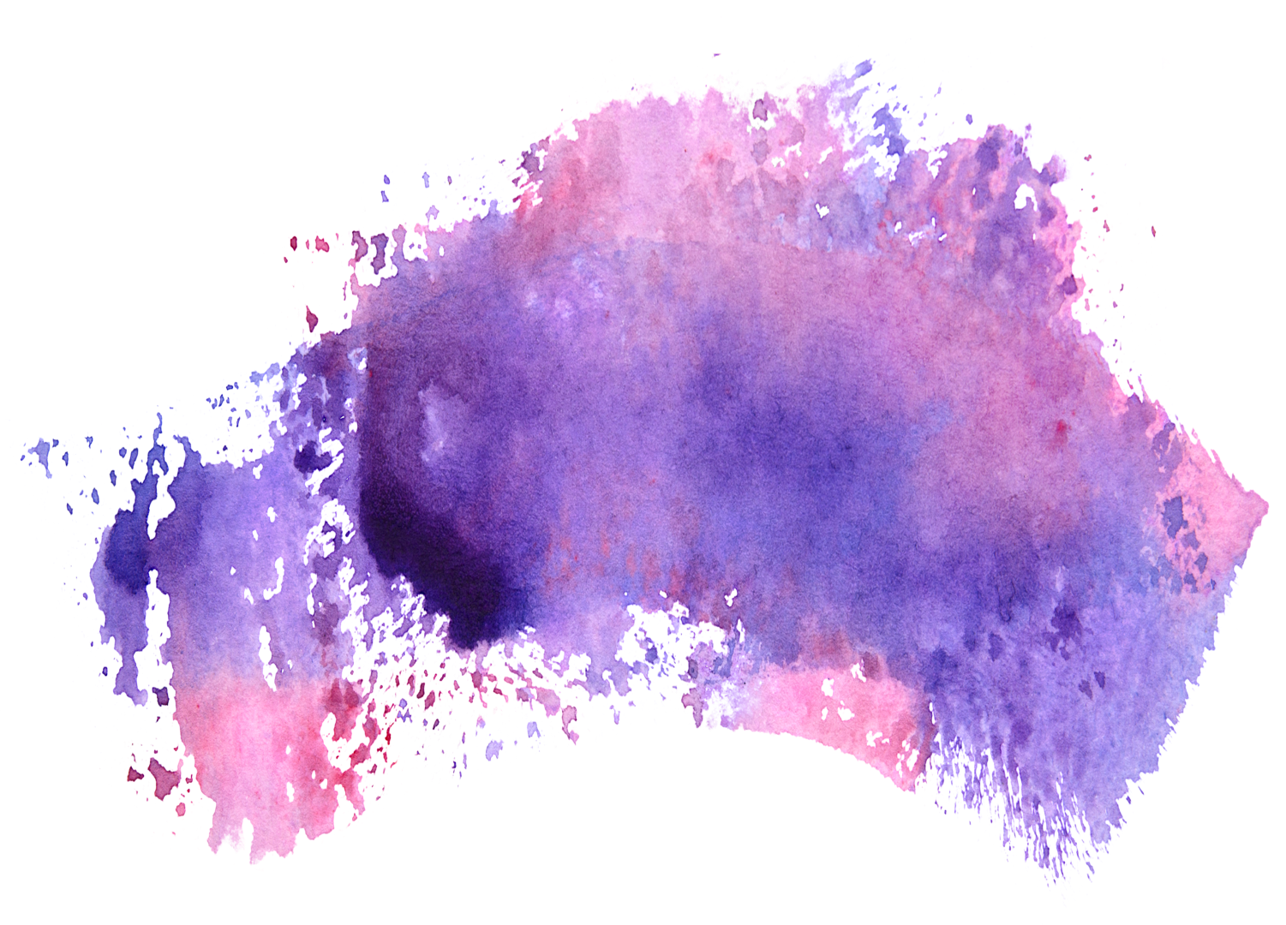
Tables to compare data

Slide 44
Use Charts to
Present data
86%
59%
50%
37%
Q1
Q2
Q3
Q4

Slide 45

Summary
We
Love
Optimizations

Slide 46
